Slide 1


P. E. Society's
Modern College of Engineering, Pune 05
Department
of
Artificial Intelligence and Data Science
Savitribai Phule Pune University (SPPU)(2021Course)
Academic Year 2021-2022
Second Year of Artificial Intelligence & DataScience Subject Code 217532
Subject- Data Structures and Algorithms Laboratory

Slide 2
“Bus administration system”
by
Group No.(A)
Group Member ID | SE_Roll_No | Group Member Name | Batch
A1 | 22571 | Shankar Karande | S3
A2 | 22537 | Ashutosh Kokate | S2
A3 | 22544 | Harshal Mahakalkar | S2
DSAL Faculty Name -Prof.Amruta Aphale

Slide 3
Project Details
Bus reservation system is a very simple project showing the implementation of class along with the object of C++ language. This project is very simple to understand, and it will help you learn how to create class and object in your C++ project/mini project. Here, the user can perform tasks like install bus information, reserve bus seat, show reservation information and show information regarding the buses available.

Slide 4
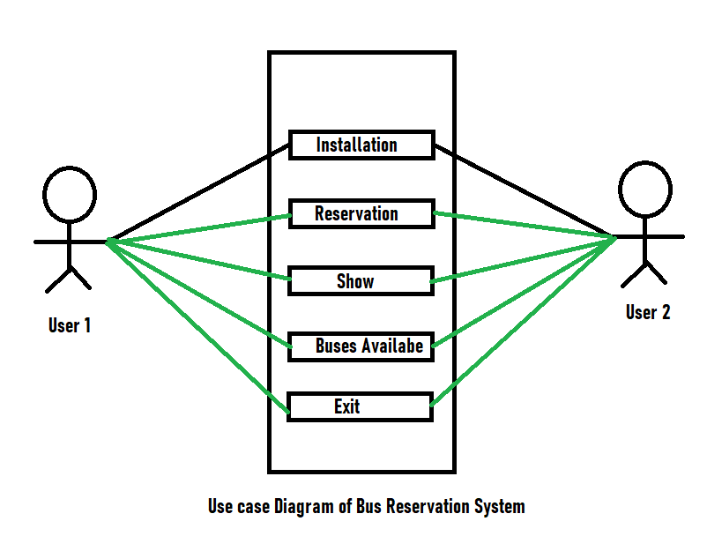
Motivation
Basically, an online reservation system allows a potential customer to book and pay for a service directly through a website. That means from the moment a customer decides they want to book a slot for your service (be it an in-house class or online appointment) to choosing a date, picking a time, and paying for the booking, membership management, everything is handled online! It greatly reduces the workload on your staff and removes the opportunity for double-bookings.

Slide 5
Problem statement
Currently, the type of system used in the counter is the internal system used manually to sell bus tickets. The company's problems are that customers have to go to the counter to buy a bus ticket or ask for a bus system, customers will also have to wait in line for longer to get a bus ticket and will also have to pay cash when they buy a bus ticket.
Hence, we are built basic level of online bus reservation system. By using this system user are not waiting in queue.

Slide 6
Aim and Objectives of the Project
The main objective of the Railway Reservation System is to manage the details of Bus, Booking, Installation, Seat, Ticket. It manages all the information about Bus, Customer, Ticket, Train.
This system project is made as user friendly as possible so that any one can use it with little knowledge of system computers.
The objective of my project is to make easy the ticket booking project system of Ticket Booking Agency simple, reliable, user friendly, and corrective. Moreover less time consuming as compared to manual work.

Slide 7
Aim and Objectives of the Project
The ticket booking project will reduce the ticket booking tedious job of system paperwork by keeping all the project details of bus ticket booking, cancelling tickets are stored in the form database in computer’s hard disk this is our aim.
Ticket activities.
Assign a bus Tickets according to customer’s demand.
Installation.
Reservation.
Buses Available.
Exit.

Slide 8
Introduction
Discussing the highlights of this Simple framework of Bus Reservation System, the client can view the list, book tickets, bus information, reserve bus seat, show reservation information and show information regarding the buses available. While booking tickets. This mini project gives us actual ideas about how to clients book tickets via online application and website and how this system work on background. This system are also easy to use and user-friendly for clients and users.

Slide 9
Background / Existing System Problems
In bus reservation system project, file has not been used to store the data of bus information. So, upon every run of the program, previously stored data regarding the aforementioned features are lost.
There are multiple tools for creating this type project. We are used visual studio code V-16.11.10 and code name dev16.
This project build in C++.

Slide 10
Background / Existing System Problems
Advantages
Online booking systems save your staff time.
Online booking systems save your staff time.
Online booking systems save your staff time.
Greater sales and marketing synergy.
Disadvantages
You need internet access. Reliable internet access is required to check reservations and add bookings that are made over the phone.

Slide 11
Methodology
Install of Bus Information
This feature allows you to install a typical bus information before it can be reserved by the passengers or shown in buses available. It includes the bus no., driver’s name, arrival time, departure time and destination (from and to) of the bus.
Reservation
This feature is very simple; it includes the bus no., seat number and the passenger’s name. The seat number of the particular bus is reserved under the passenger’s name.

Slide 12
Methodology
Show Reservation Information
This feature is very simple; it includes the bus no., seat number and the passenger’s name. The seat number of the particular bus is reserved under the passenger’s name.
Buses Available
This feature simply shows the buses available for reservation, and the information regarding the bus no. stored under the first feature.

Slide 13
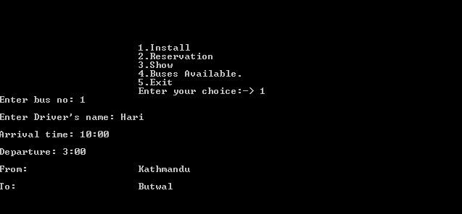
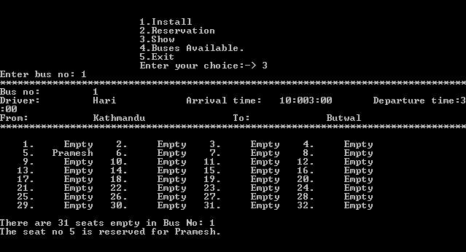
Implementation
We are encouraged to incorporate file handling in this project to store all the bus details, and make the project more effective and complete overall. This is a very simple project, IT show the implementation processes and techniques of class and object of the C++ language.

Slide 14
Conclusion
Our project online bus reservation system provides an easy way for booking the bus tickets. Also it makes the customer easy to get and reserve bus tickets online instead of queue up to buy bus tickets.
Get this project Here : https://github.com/shankarkarande/Bus-Administration-System

Slide 15
References
Laweb,(2010): "Central Reservation System | Online Hotel Marketing Services, Hong Kong and Philippines Hotel, Spa and Restaurant Software". Iaweb.net. 2010. Retrieved 2012-11-08
Wee K. L. (2007): Bus Reservation System: Faculty of Information and Communications Technology,Universiti technical Malaysia Melaka.
Kevin O. C., (2012): Web-Based Bus Reservation and Ticketing System: College of Computer Studies, Ateneo de Naga University, Naga City, Philippines.
Madden A .D., (2000): "A definition of information", Aslib Proceedings, Vol. 52 Iss: 9, pp.343 – 349

